Slide 1
Unquoted Service Path
Matthew Wold

Slide 2
Agenda
Lets talk about Unquoted Service Paths!
Demonstration of an Unquoted Service Path vulnerability
How the Unquoted Service Path was discovered in Palo Alto Cortex XDR.

Slide 3
Deep Dive Unquoted Service Paths
What is an Unquoted Service Path?
Why are Unquoted Service Paths dangerous?
How do you find Unquoted Service Paths?
How do you remediate Unquoted Service Path vulnerabilities?

Slide 4
Services
Windows services are long-running executable applications that run in the background.
Services can be configured to auto-start when the computer is powered on.
Services run with elevated permissions.

Slide 5
Service Paths
Service Paths can be found in the registry:
HKLM\System\ControlSet001\Services
Services only need to be quoted if there are spaces in the path
Example of the Print Spooler service without quotes because there are no spaces in the ImagePath.

Slide 6
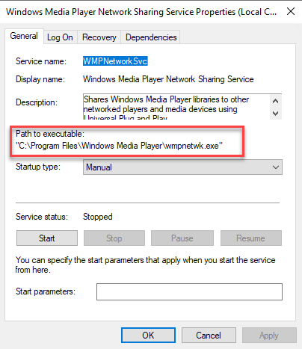
Quoted Service Paths
Example:
Without the quoted path Windows would be confused as to what the system wanted to run.
Windows would try to run each of the folders as potential applications:
“C:\Program.exe”
“C:\Program Files\Windows.exe”
“C:\Program Files\Windows Media.exe”
“C:\Program Files\Windows Media Player\wmpnetwk.exe”

Slide 7
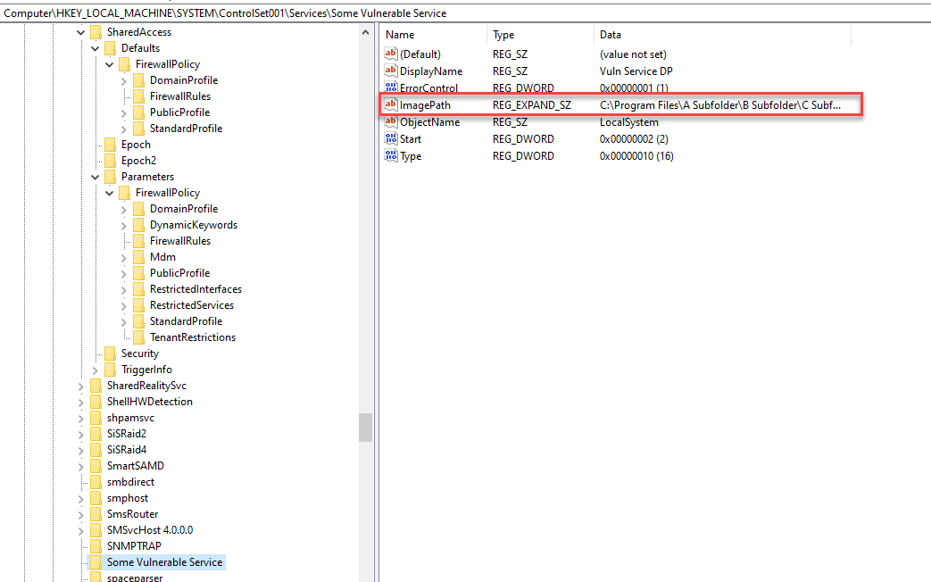
Unquoted Service Path
Example:

Slide 8
Unquoted Service Path
In Windows environments when a service is started the system attempts to find the location of the executable in order to successfully launch the service.
If the path to the executable doesn’t contain spaces or is enclosed in quotes then the system will know where to find it.
If the path to the application binary contains spaces and is unquoted, Windows will try to locate and execute it inside every folder path until it reaches the executable.

Slide 9
Dangers of Unquoted Services
Privilege Escalation
Ransomware
Malware
Reverse Shells

Slide 10
Discover Unquoted Service Path
Using Vulnerability Management software such as Rapid7 InsightVM or Nessus.
Manual search using WMIC Service

Slide 11
Remediate Unquoted Service Paths
With an administrator account open Registry Editor as admin.
Locate the unquoted service path registry entry.
Edit the service path by wrapping it in quotes.
If this is commercial software, you should reach out to the vendor to update and secure their software. Update the application as soon as possible.

Slide 12
Demonstration
Unquoted Service Path Vulnerability

Slide 13
Escalate Privileges
1. Check Privileges
2. Check for Unquoted Services
3. Check folder access
4. Build payload
5. Exploit

Slide 14
Tools
net user command
wmic service command
icacls command
PowerSploit – PowerUp.ps1 module

Slide 15
Congratulations!
You’re a system administrator now

Slide 16
Palo Alto Cortex XDR Unquoted Service Path Vulnerability
Discovered with Rapid7 InsightVM
Installed Cortex XDR (version 7.7.0) into a security lab machine and verified that it was installed with unquoted service path
C:\Program Files\Palo Alto Networks\Traps\cyserver.exe
Used Metasploit MSFVenom to create a payload to exploit called “Program.exe” in C:\
Used a blank text file called Program.exe in C:\ as well.

Slide 17
Source Credits
Brian Johnson
7 Minute Security
Sumit Verma
Medium.com
Red Teaming Experiments
Ired.team
Unnamed Security Partner*
Unnamed System Admin Partner*
*Security partners unnamed at their request

